Slide 1
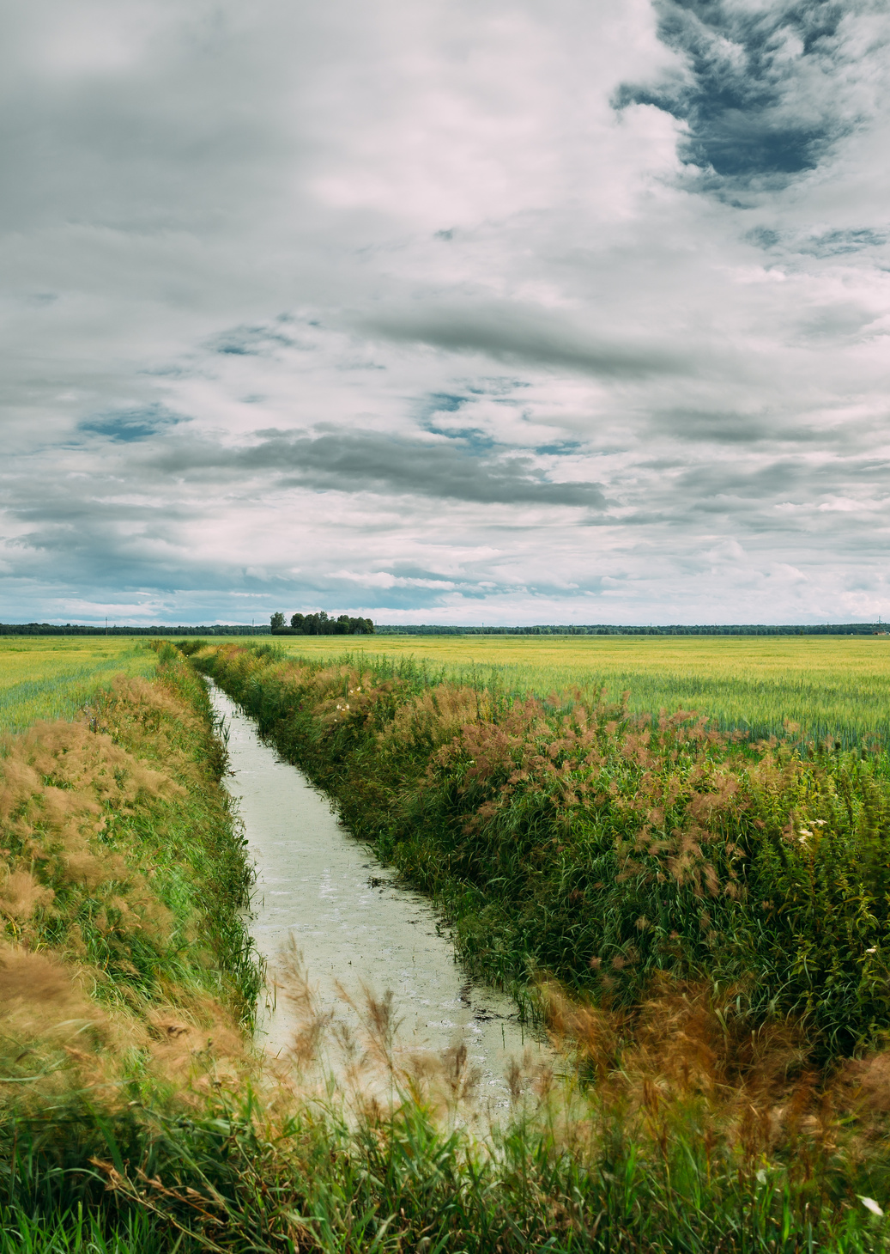


CE 299: Project Course
Evaluating the Impact of Canal Irrigation on Agricultural Command Areas in India
Guided by
Prof. Vimal Mishra
Hiren Solanki
Presented By
Maitri Chaudhari (23110192)
Peddinte Jasmitha (23110244)
Reddy Pujitha Reddy (23110275)

Slide 2
Table of Contents
01
Introduction
05
Growing Demands
Changing Climate and Greening Vegetation
02
Data Used
06
03
Methodoly
07
Conclusion
04
Major Canals

Slide 3

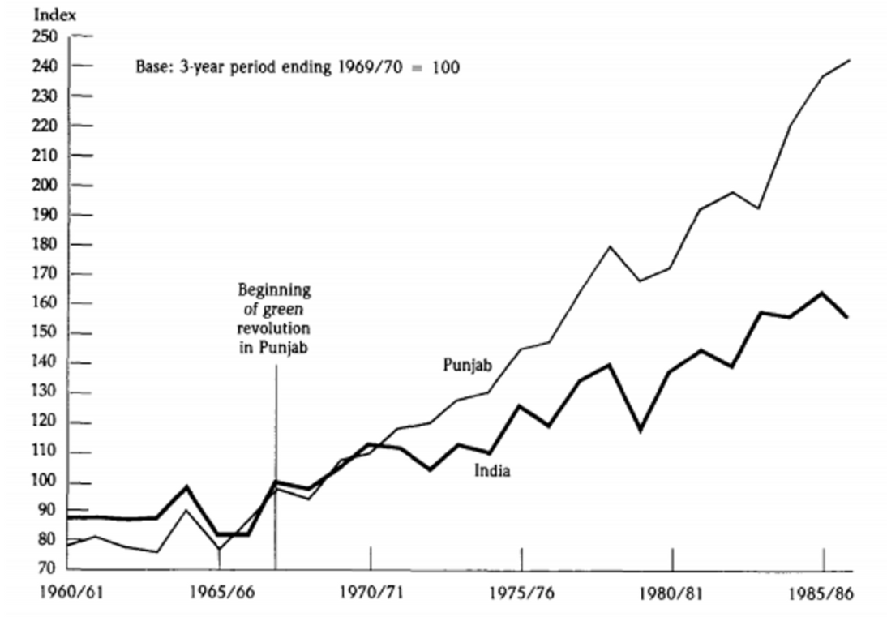
Canal Irrigation and the Green Revolution in India
Chart: Agriculture Is the Biggest Employer in India | Statista
Index of agricultural production: India and Punjab

Slide 4
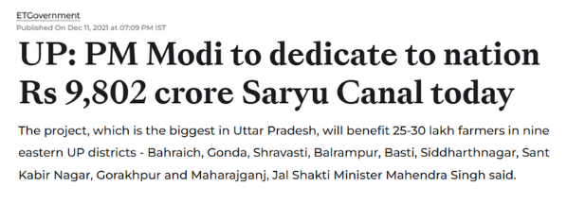
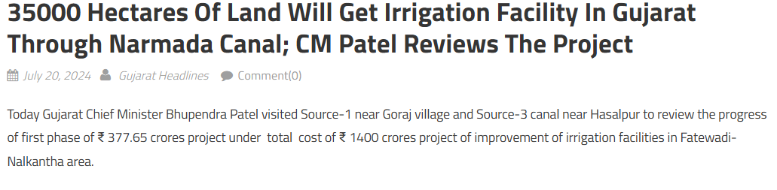
Canal Projects Driving Agricultural Change
Large-scale canal projects like the Saryu Canal and Narmada Canal are crucial to agriculture. Our study assesses how such investments impact agricultural command areas.
https://www.gujaratheadline.com/NarmadaCanal
https://infra.economictimes/PM dedicating money in Saryu Canal Project

Slide 5
Data Used for this Study
Satellite Datasets Used in the Study with Their Spatial and Temporal Resolutions
Data | Source | Spatial Resolution | Temporal Resolution
Rainfall | CHIRPS | 5.56 km | Daily (2000-2023)
NDVI | MODIS | 250 m | Every 16 days ( 2000-2023)
LULC | MODIS | 250 m | Every 16 days ( 2000-2023)
LAI | MODIS | 250 m | Every 16 days ( 2000-2023)
NDVI_Spatial | COPERNICUS | 10 m | Every 5 days

Slide 6
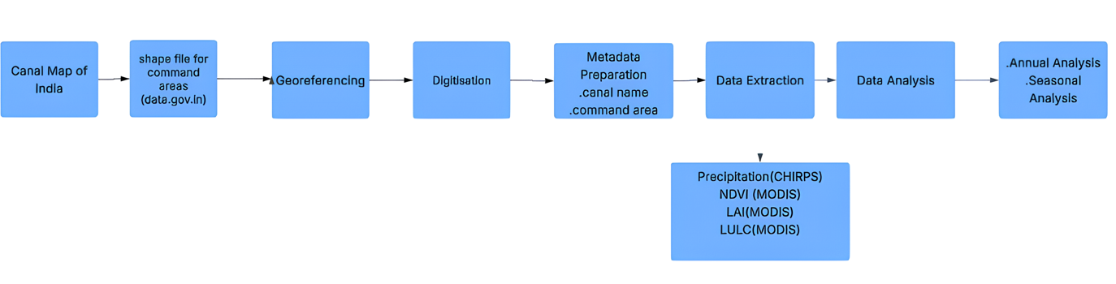
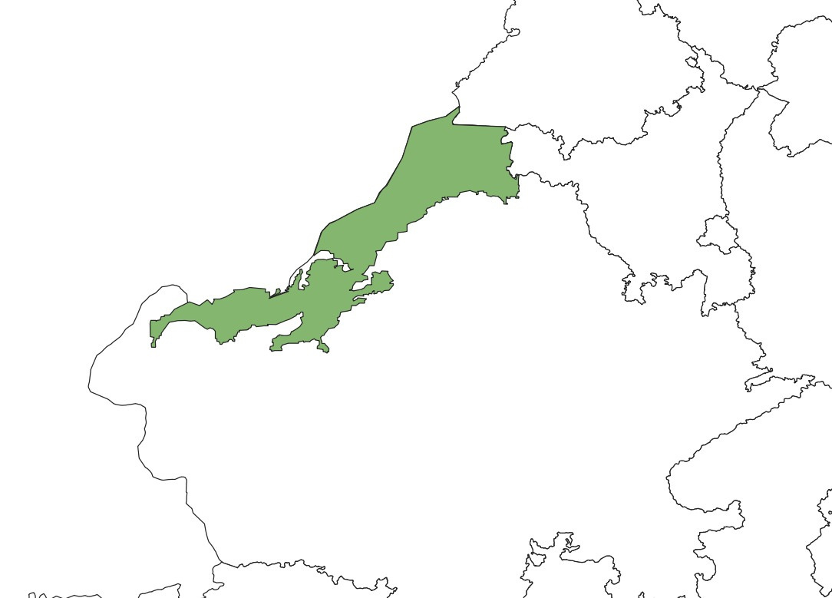
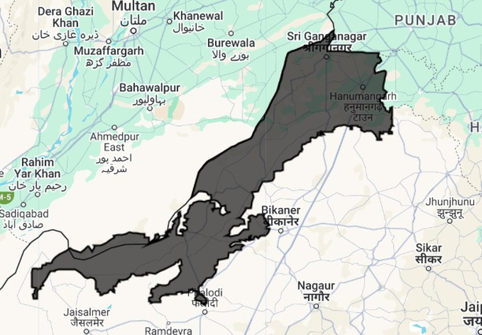
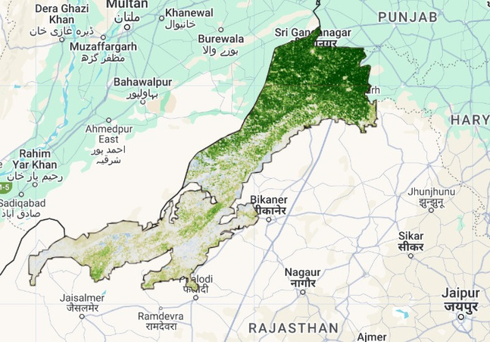
METHODOLOGY
Indira Gandhi Canal Command Area
Clipped Indira Gandhi Canal Command Area in GEE
Cloud Masked NDVI Spatial Distribution of the Command Area

Slide 7
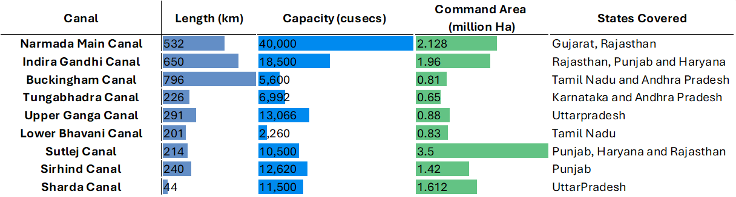
Major Canals in India
"Key Characteristics of Major Canal Systems in India: Length, Capacity, Command Area, and States Benefited"

Slide 8
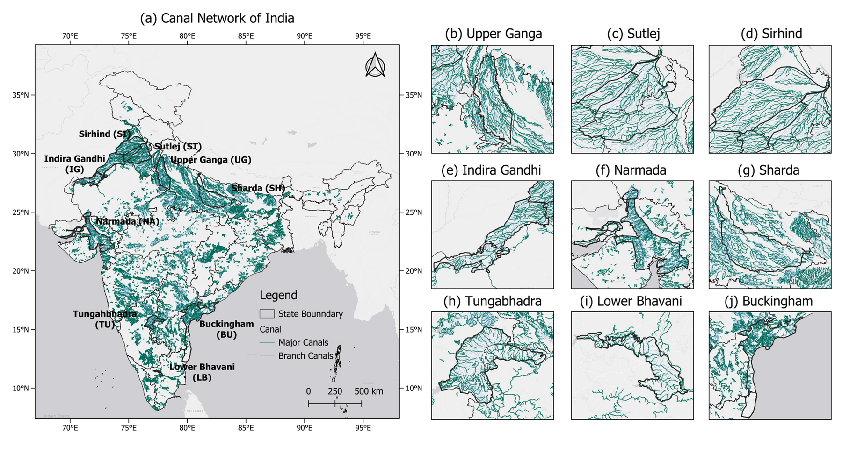
Major Canals in India
Canal Network of India: Major Irrigation Canals and Their Branches

Slide 9
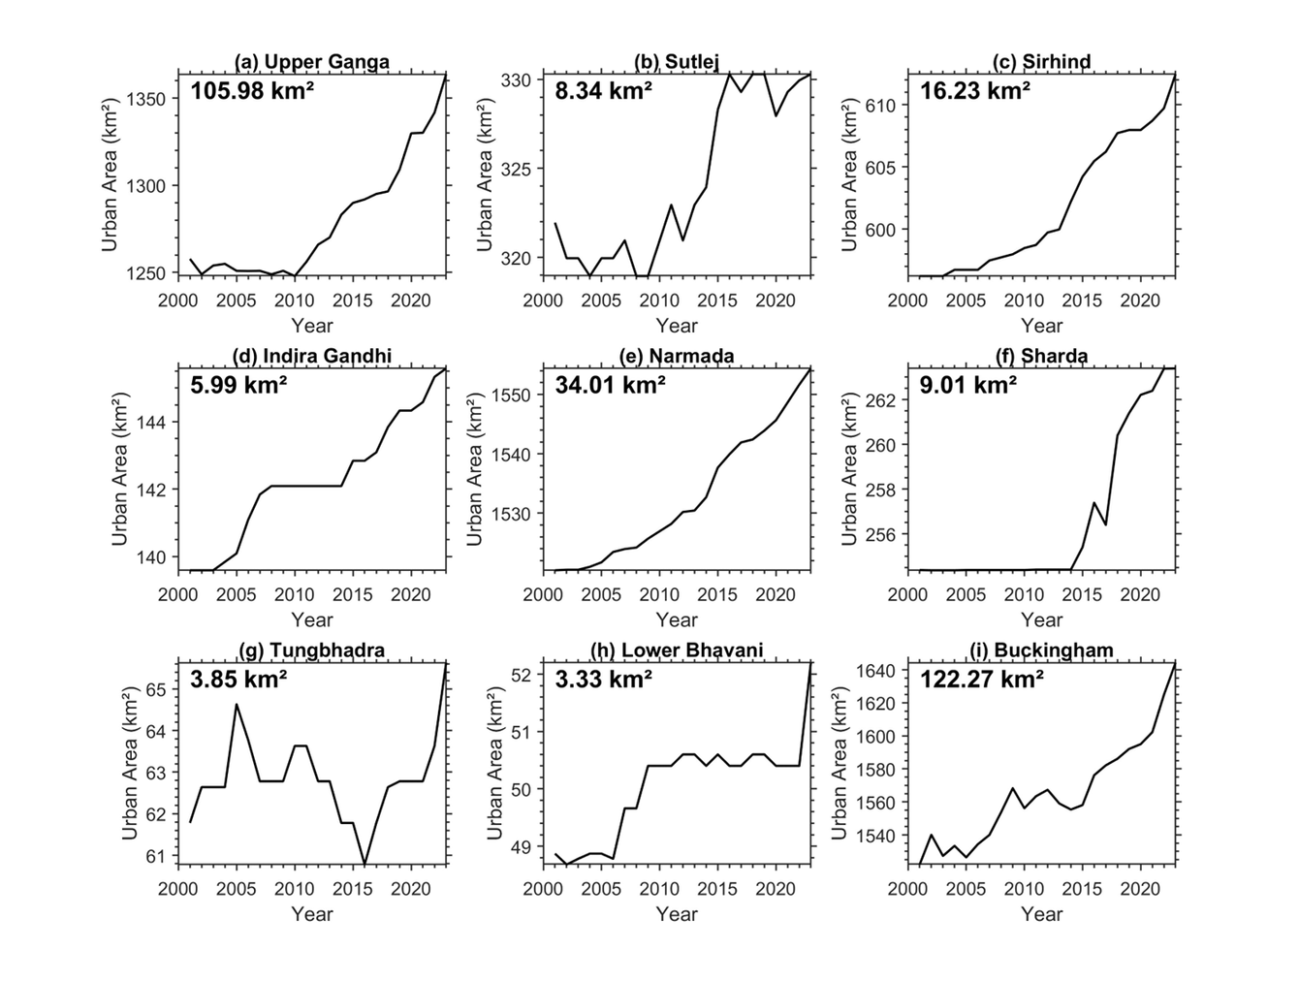
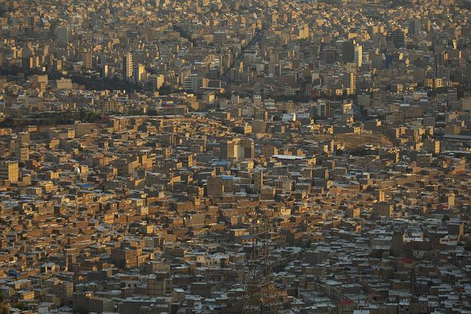
Growing Demand
As urban areas continue to expand, driven by population growth and development, the demand for essential resources like food and water is also rising sharply.

Slide 10
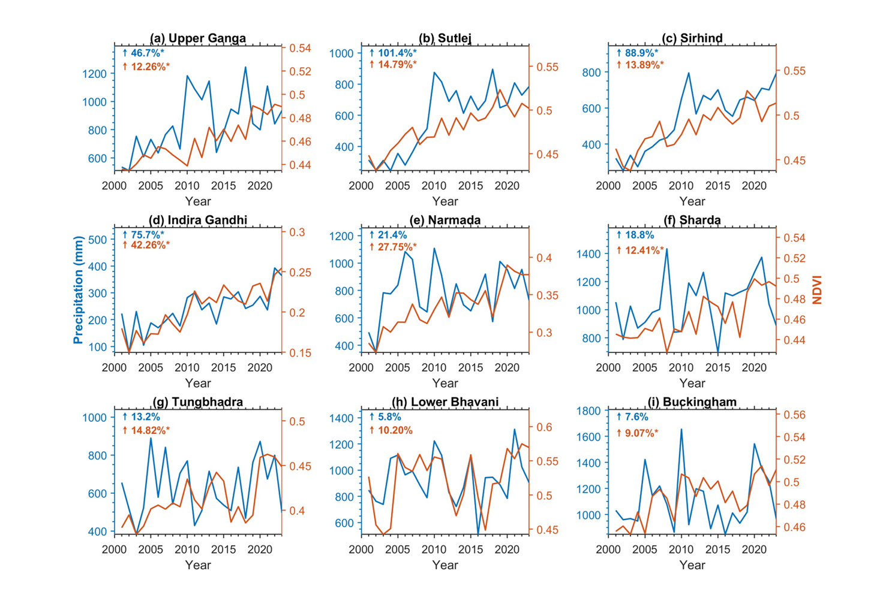
Changing Climate and Greening Vegetation
Variations in rainfall and vegetation across canal command areas suggest shifting water demand and supply patterns. Understanding these trends is essential for planning efficient canal operations and ensuring reliable irrigation.

Slide 11
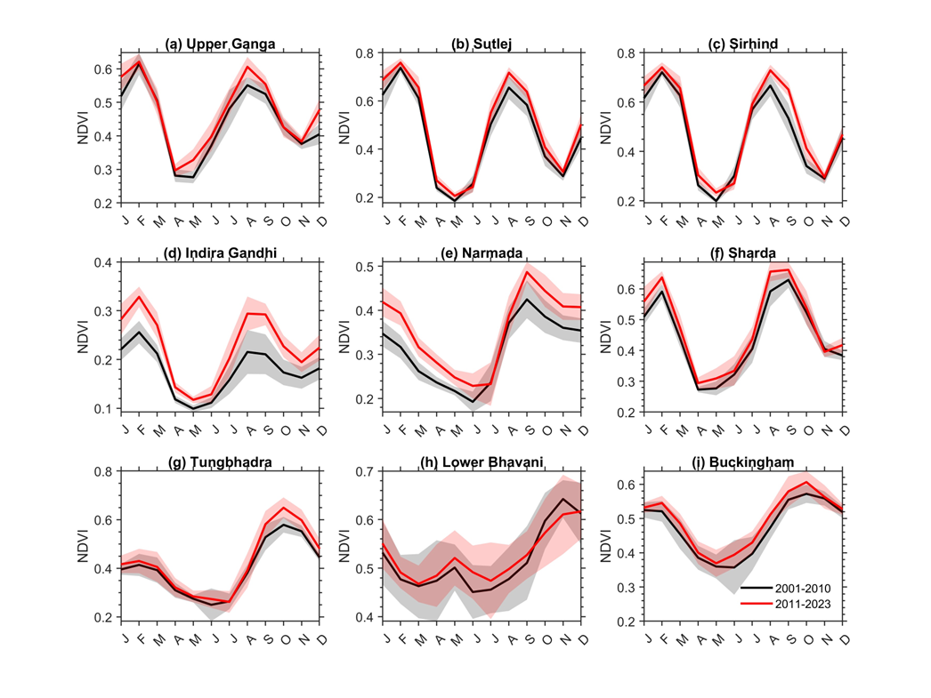
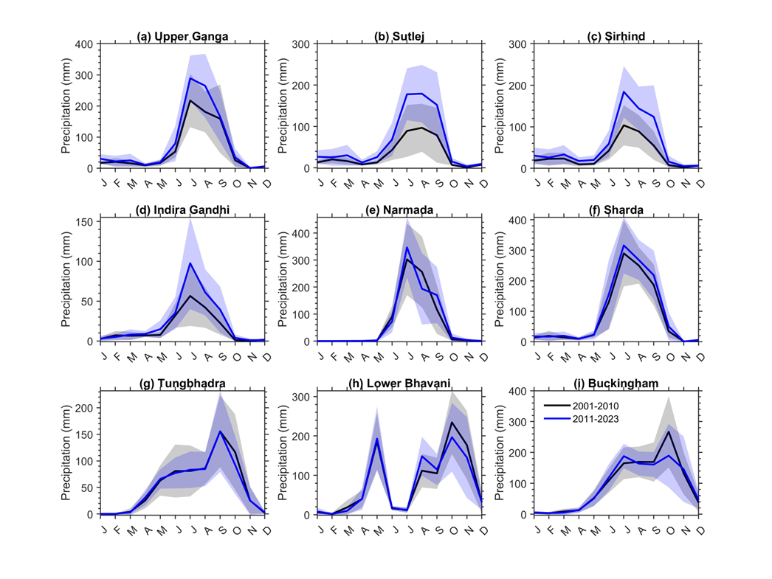
Changing Climate and Greening Vegetation
Seasonal Variations in Vegetation Greenness (NDVI) Across Two Decades
Seasonal Precipitation Patterns Over Time

Slide 12
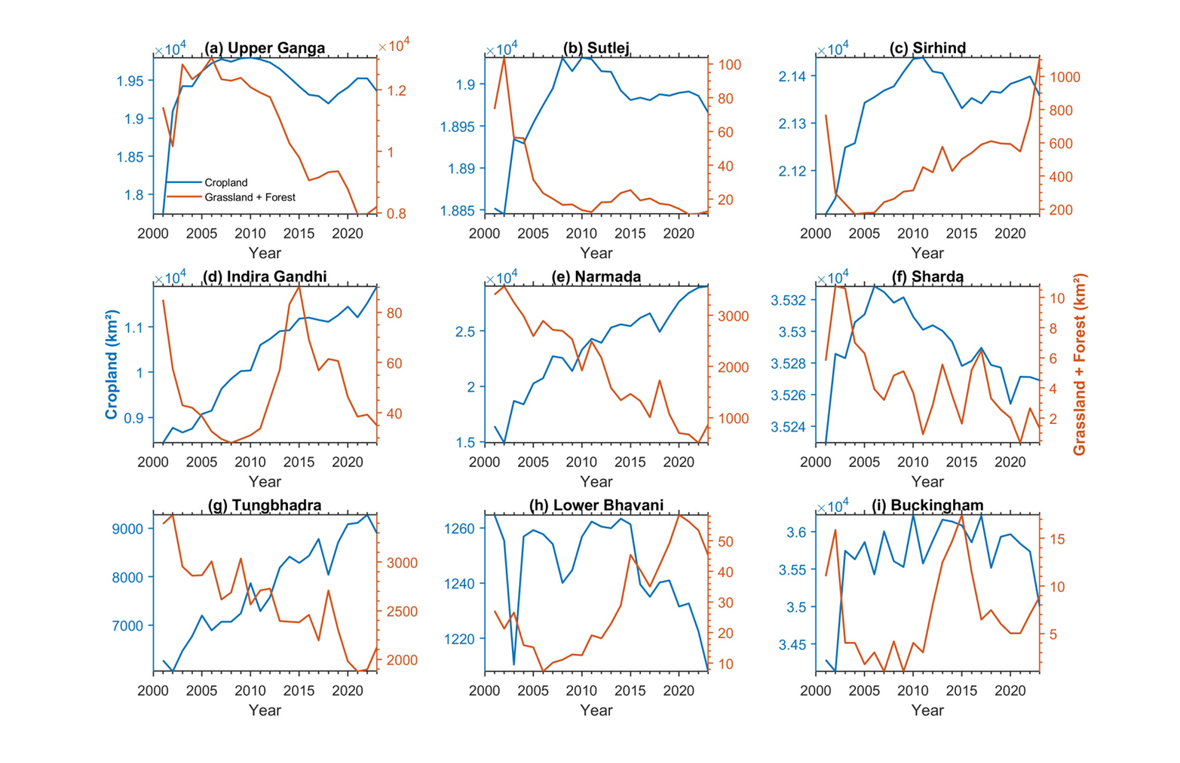
Where the greening is happening?
Analysis of forest cover and cropland extent reveals land use changes contributing to increased vegetation (greening) across regions.

Slide 13
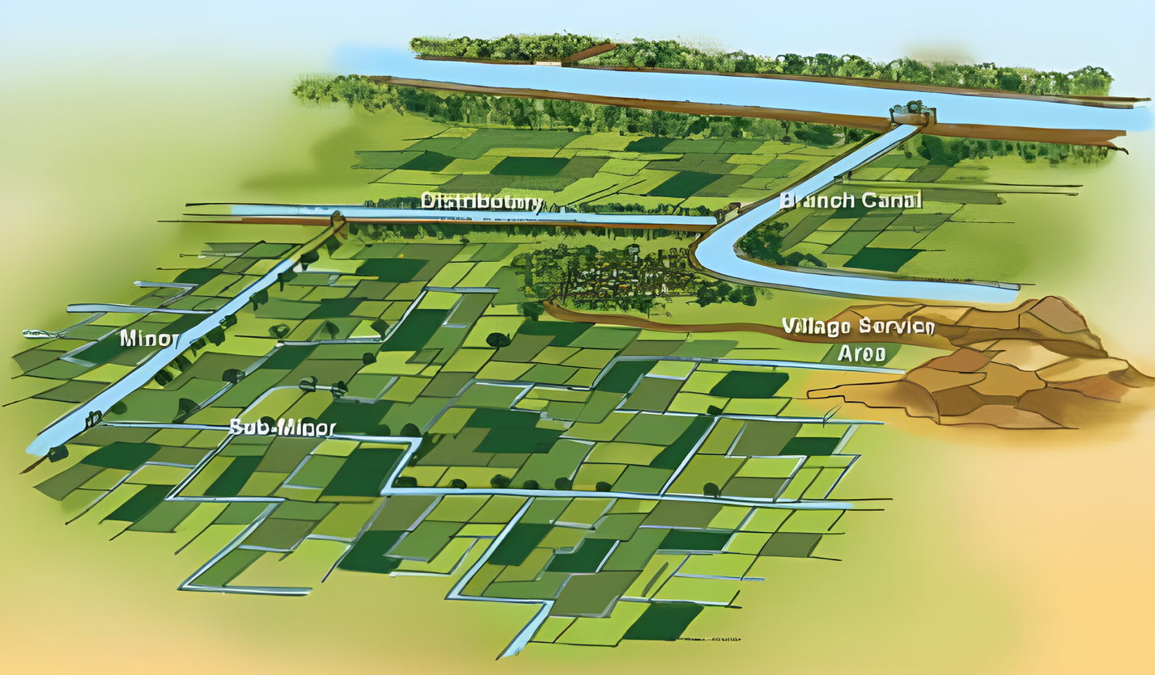
Conclusion
Our analysis shows that canal irrigation has had a significant positive impact on agricultural command areas across India. The increase in vegetation greenness (NDVI), especially during monsoon seasons, indicates improved crop health and productivity. Despite varying rainfall patterns, canal systems have helped stabilize water supply, support agricultural expansion, and meet rising demands driven by urban growth. However, this expansion is often linked to reduced forest cover, highlighting the need for balanced and sustainable land and water management.

Slide 14
THANK YOU
THANK YOU

